Slide 1
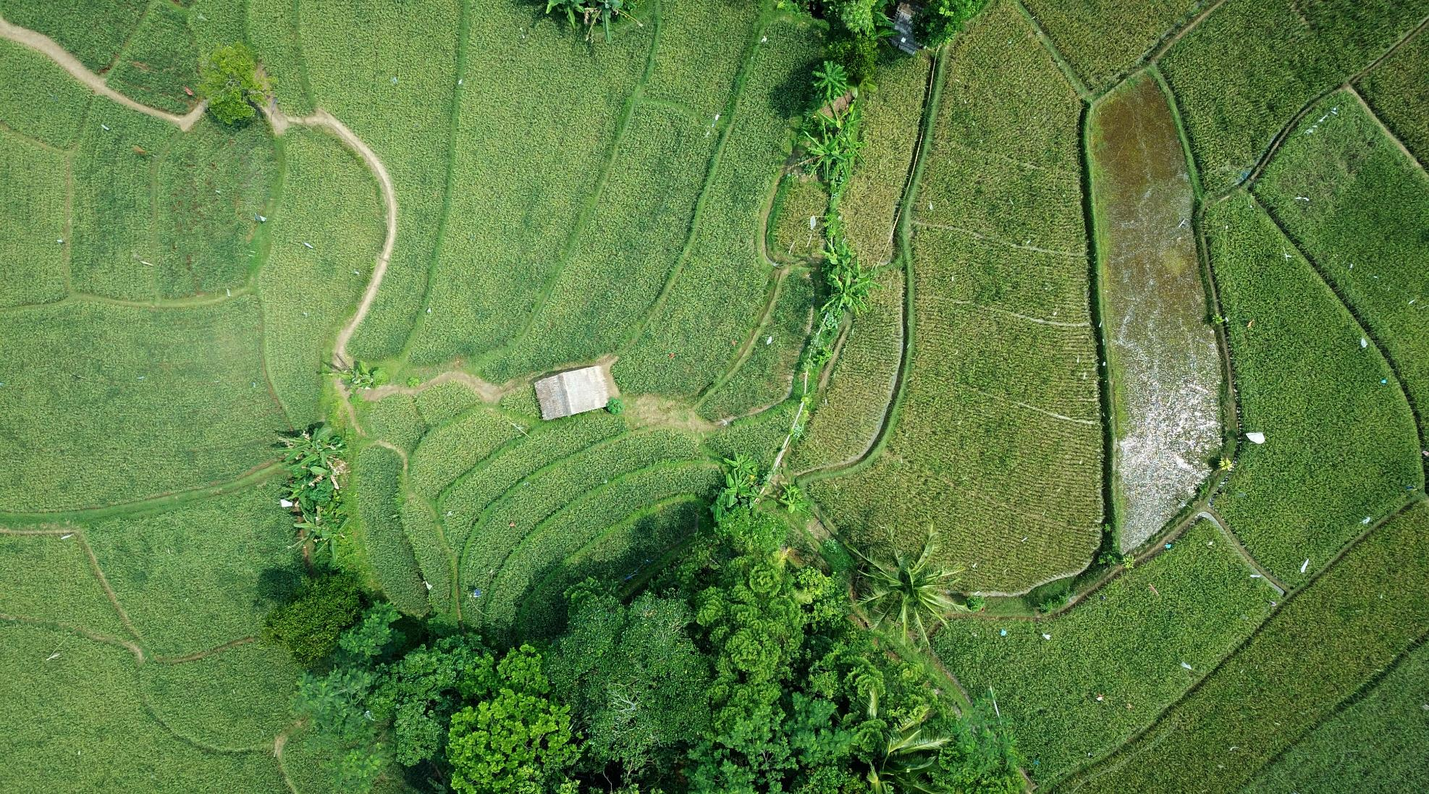


Introduction to ML
Alkis Koukos, Vassilis Sitokonstantinou, Thanassis Drivas
Beyond Center of Excellence, IAASARS, NOA

Slide 2
What is Machine Learning (ML)?
«The field of study that gives computers the ability to learn without being explicitly programmed»
Arthur Samuel (1959)
«A computer program is said to learn from experience E with respect to some class of tasks T and performance measure P, if its performance at tasks in T, as measured by P, improves with experience E »
Tom M. Mitchell (1998)

Slide 3
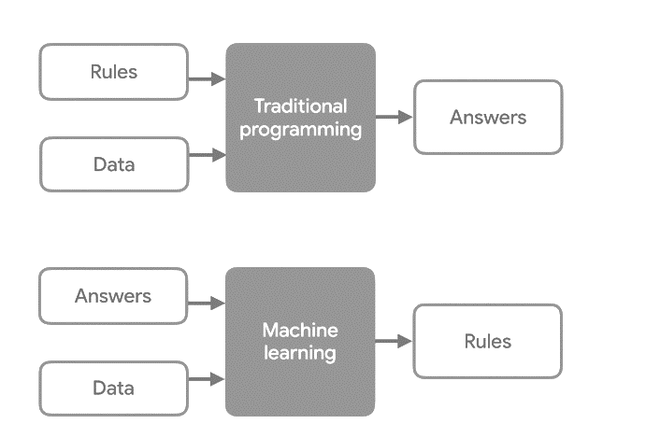
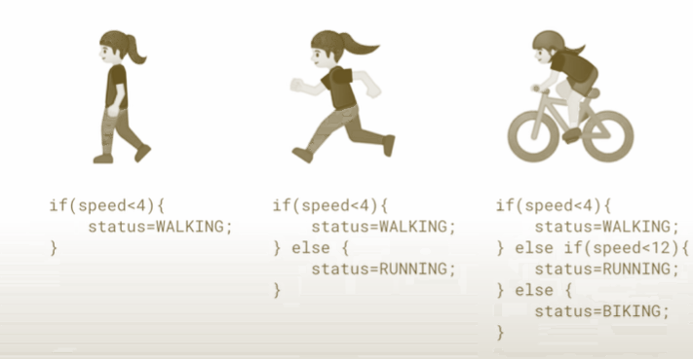

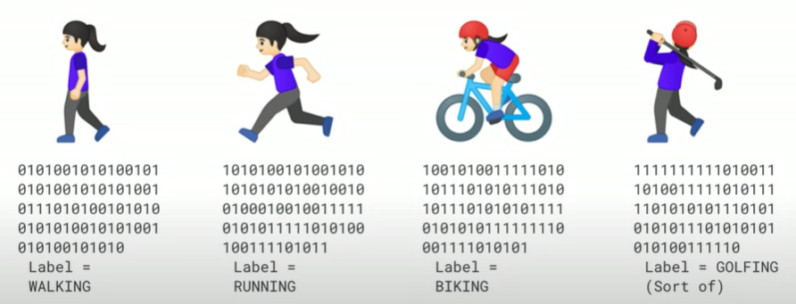
What is Machine Learning (ML)?
Activity recognition

Slide 4
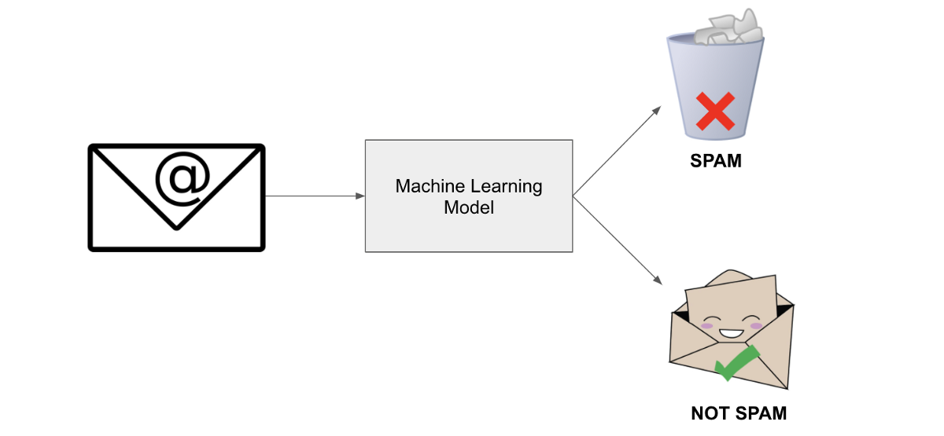
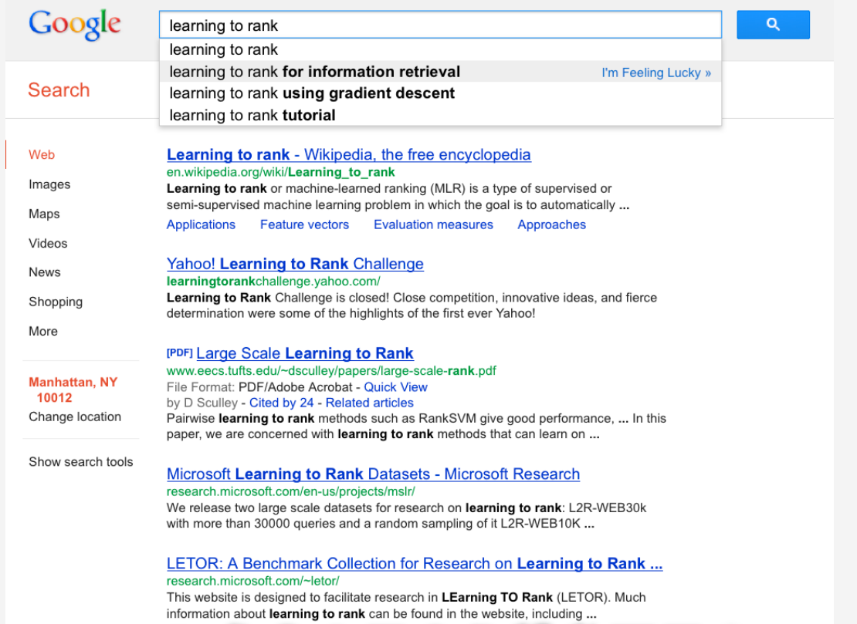
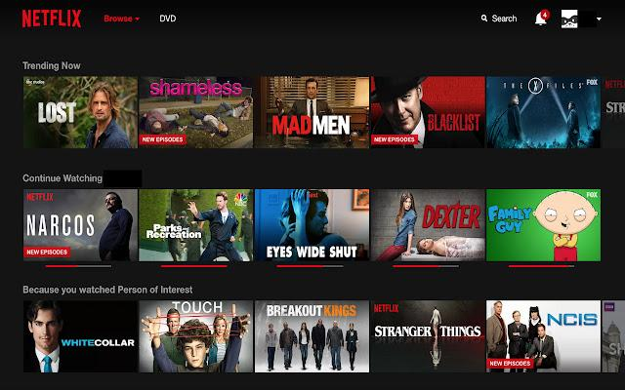
ML Applications
Spam Mail
Web search
Recommendation System

Slide 5
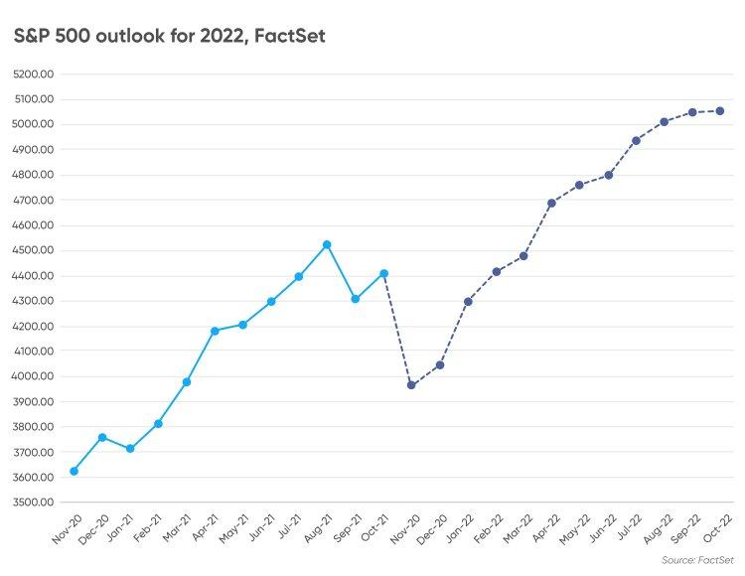
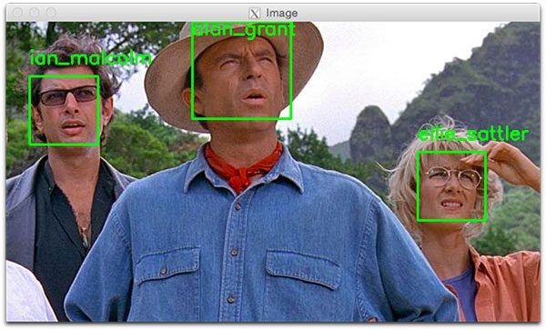
ML Applications
Stock Prediction
Face Recognition

Slide 6
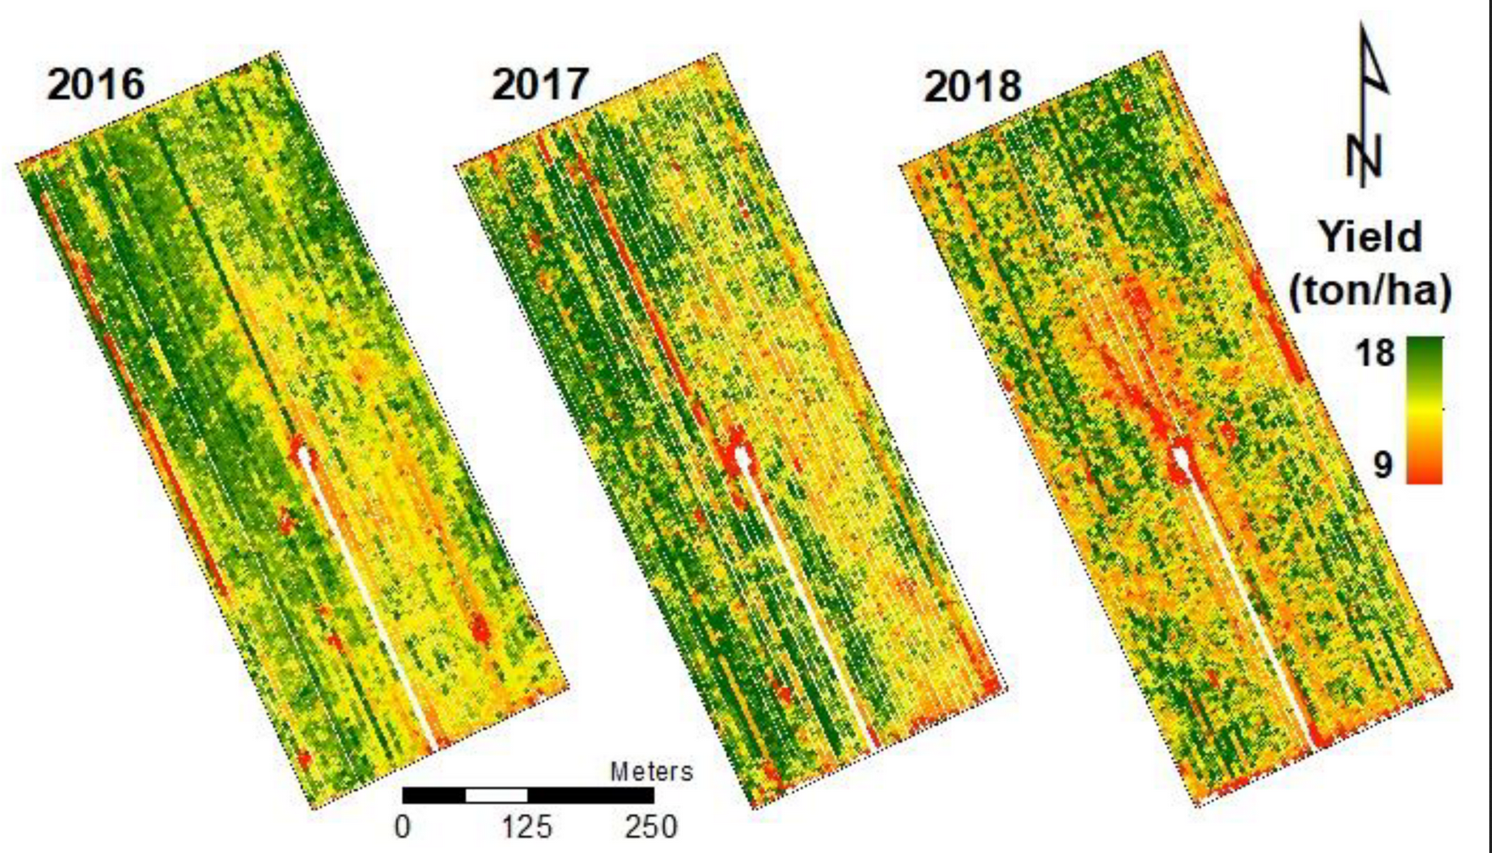
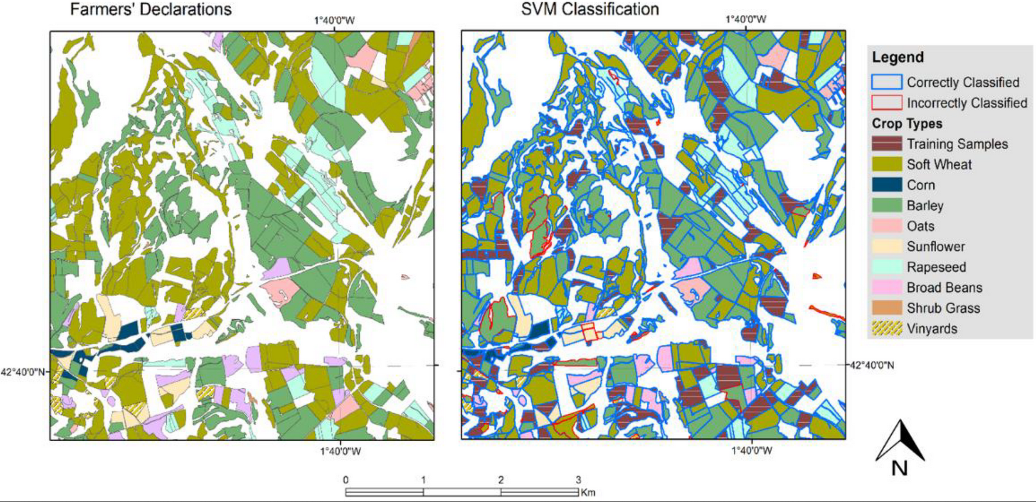
ML Applications
Yield Estimation
Crop Classification

Slide 7
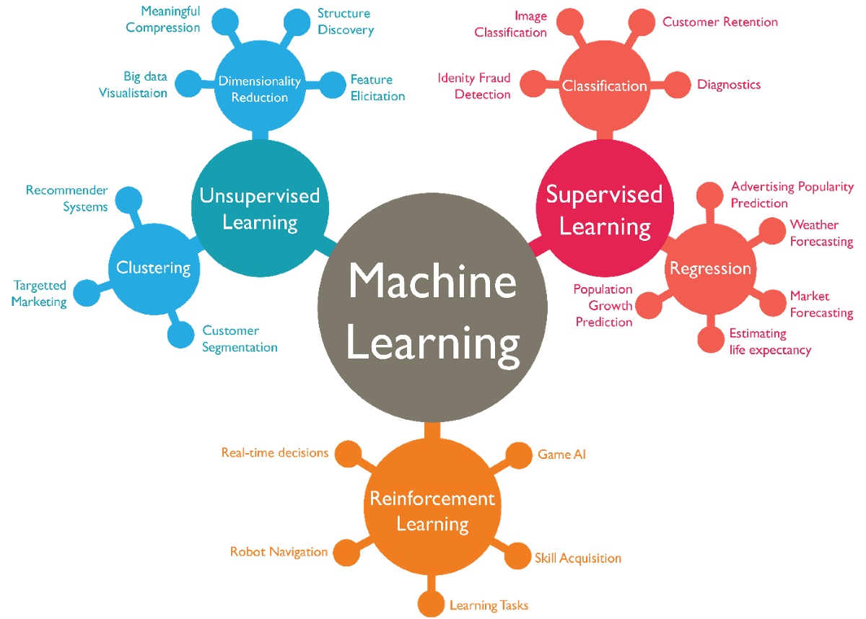
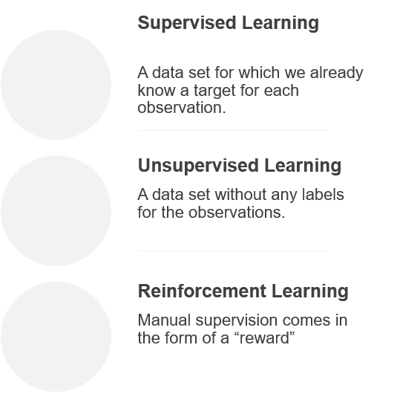
Types of Machine Learning

Slide 8
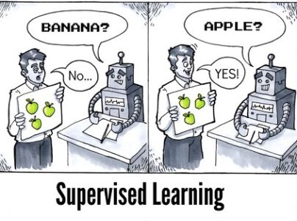
Supervised Learning (1)
Overview
The Training data includes both the input and the desired results (Targets/Labels).
For all the samples, the correct results are known and are given
in input to the model during the learning process.
The construction of a proper training, validation and test set is crucial.
The ML algorithm learns the mapping function from the input to the output Y = f(X).
Have to be able to generalize: give the correct results when new data are given in input without knowing a priori the target.
If the Data is Discrete we’re dealing with a Classification Problem, if it is continuous we’re dealing with a Regression Problem.

Slide 9
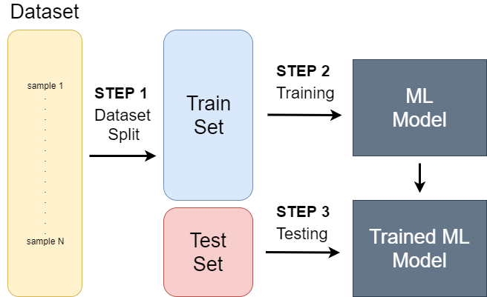
Supervised Learning (2)
Dataset Splitting

Slide 10
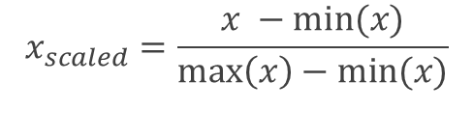
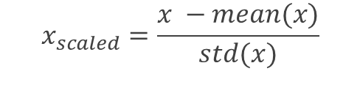
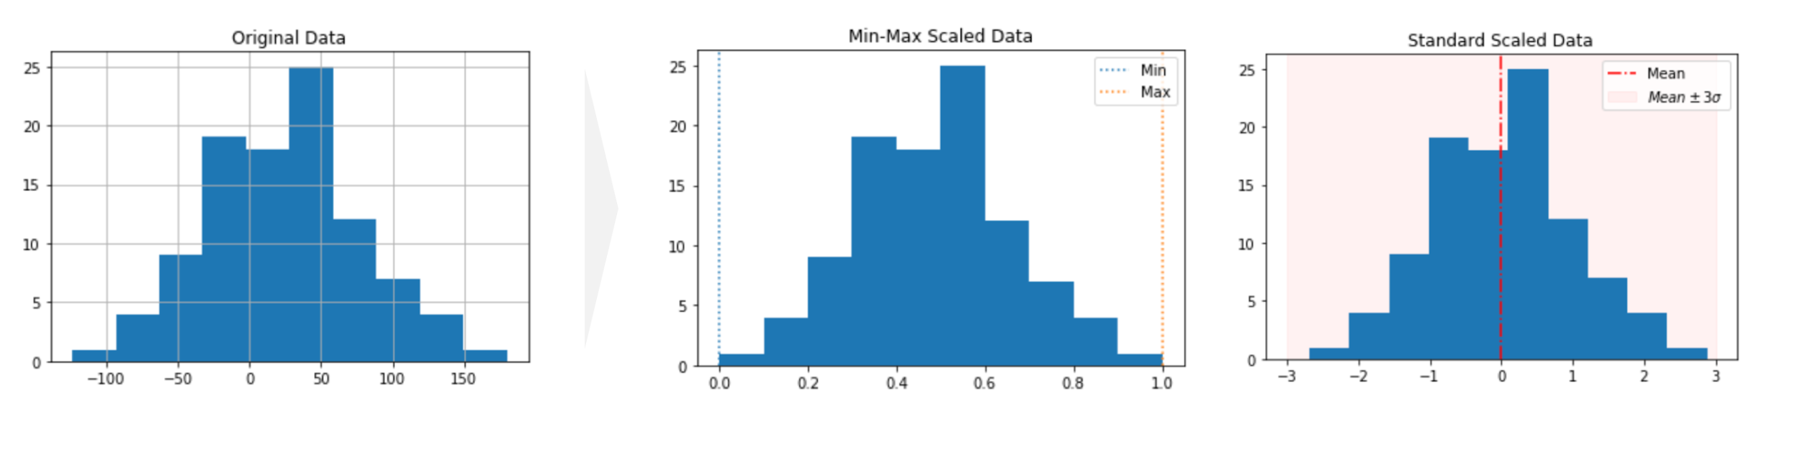
Supervised Learning (2)
Dataset Normalization
Min – Max Scaling
Standard Scaling

Slide 11
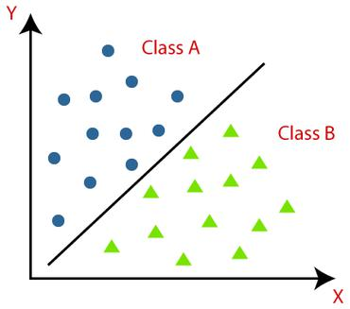
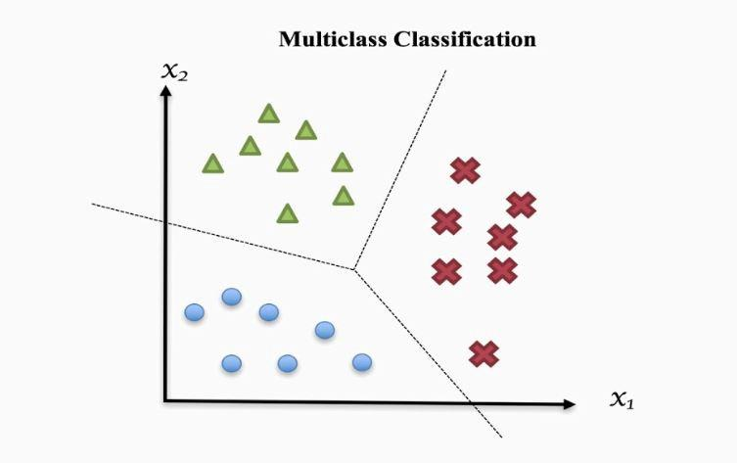
Supervised Learning (3)
Classification
Binary Classification Multi-class Classification
Source: https://paperswithcode.com/task/classification/codeless
https://towardsdatascience.com/multi-class-classification-one-vs-all-one-vs-one-94daed32a87b

Slide 12
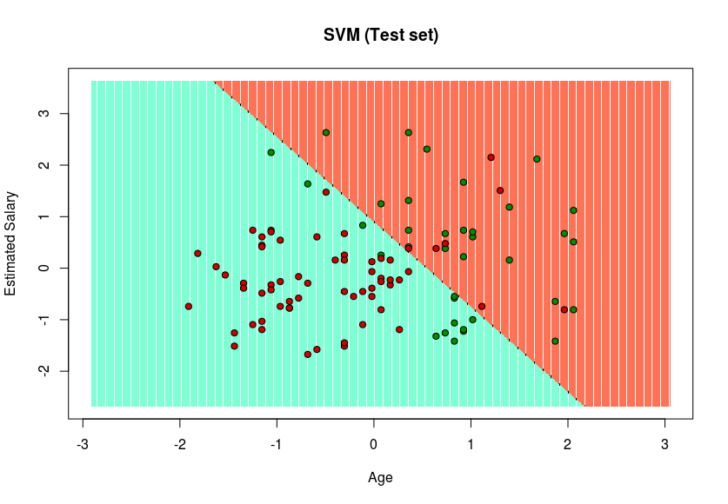
Supervised Learning (4)
Apply the model

Slide 13
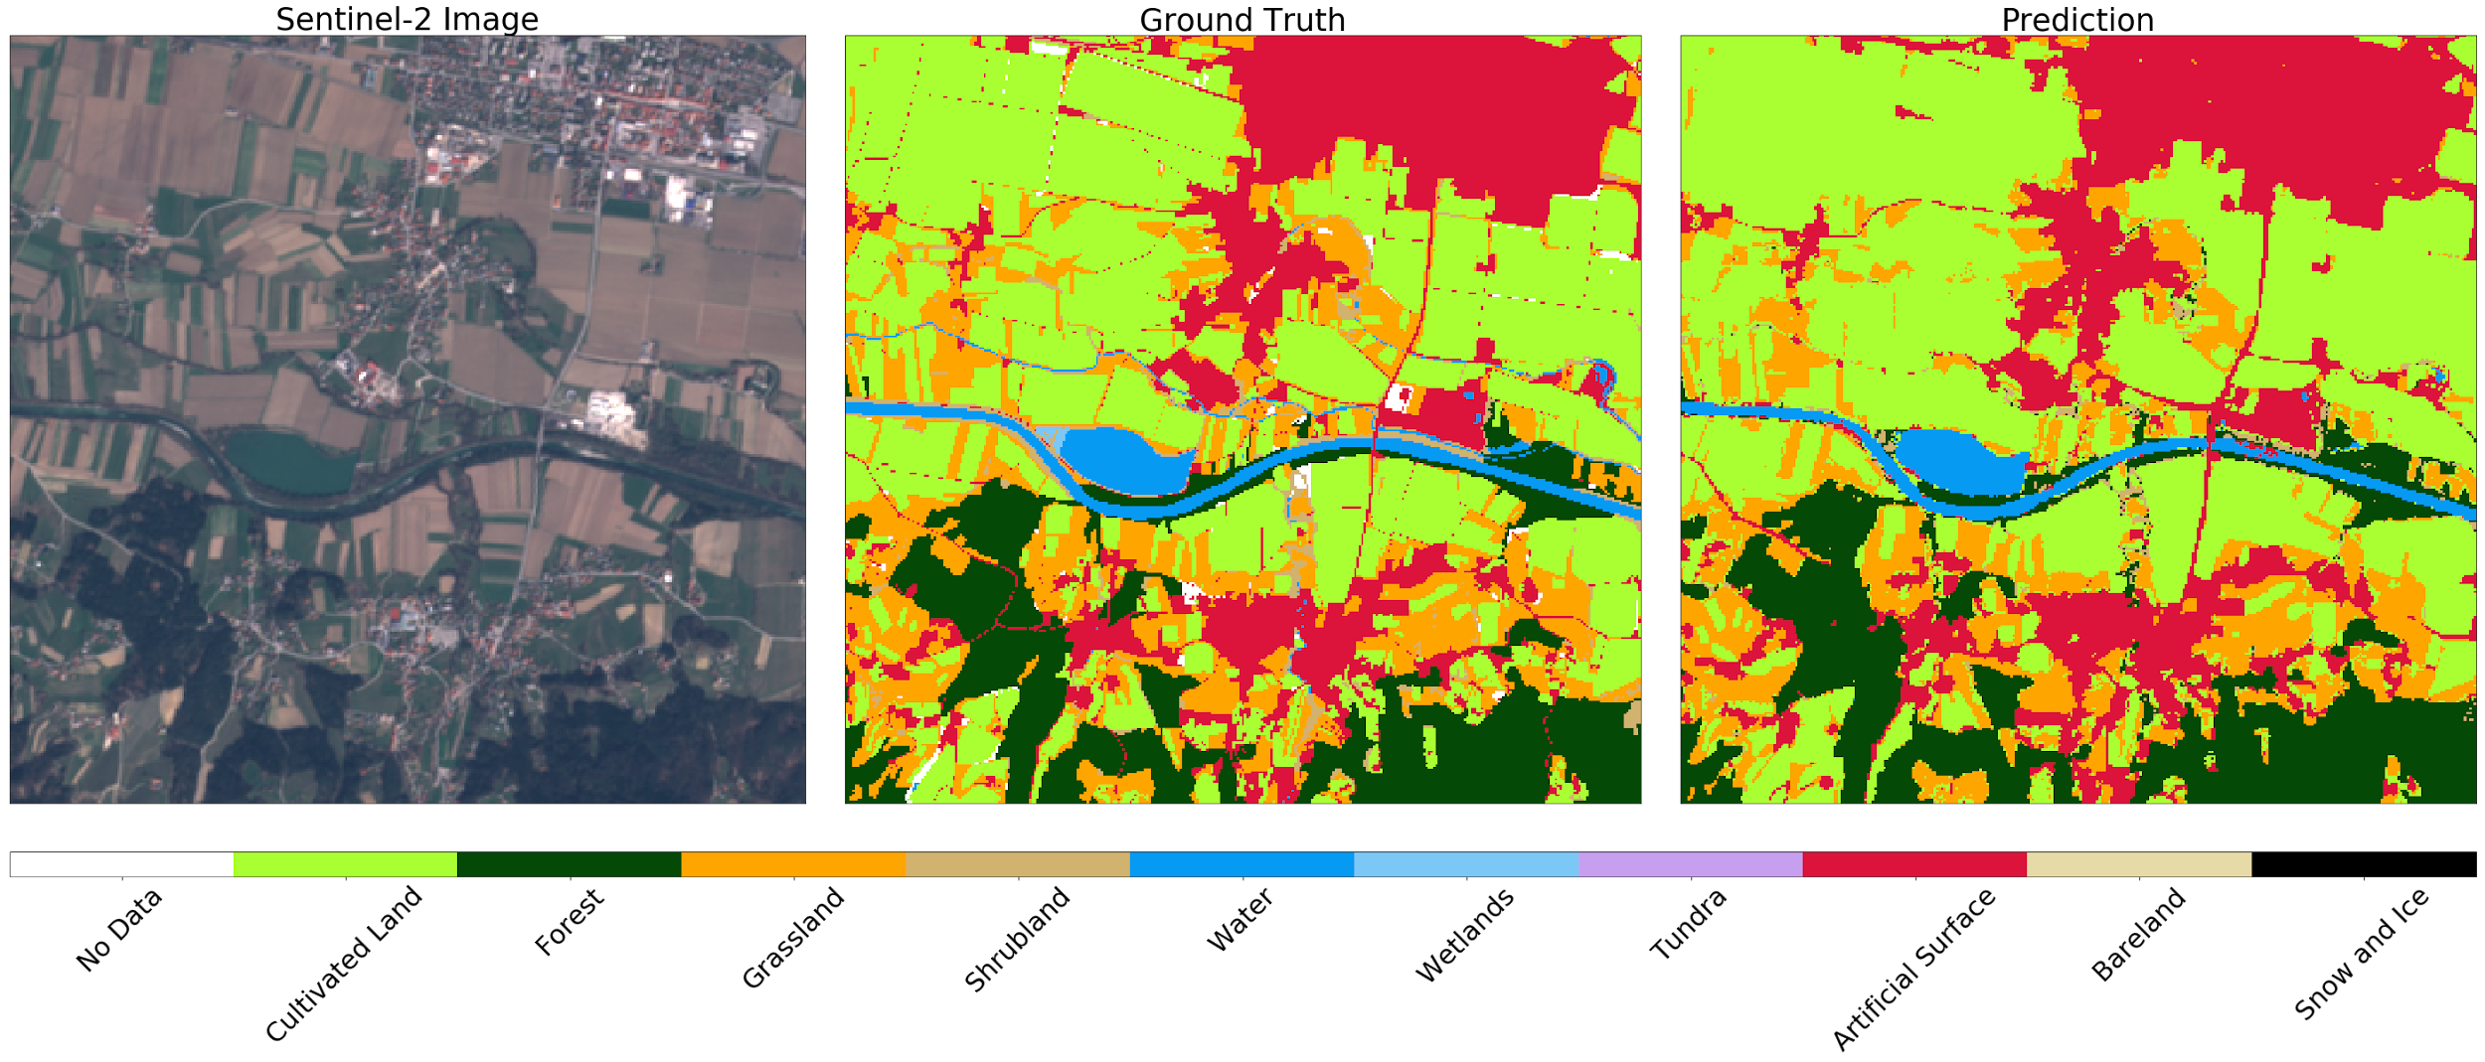
Supervised Learning (5)
Remote Sensing Example: Crop Classification
Source: https://medium.com/sentinel-hub/land-cover-classification-with-eo-learn-part-2-bd9aa86f8500

Slide 14
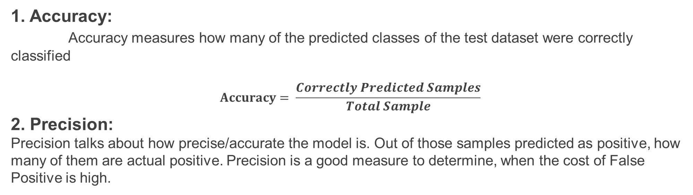
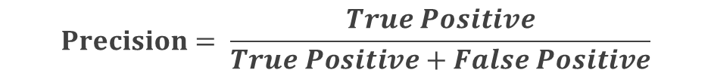
Supervised Learning (6)
Evaluation Metrics

Slide 15
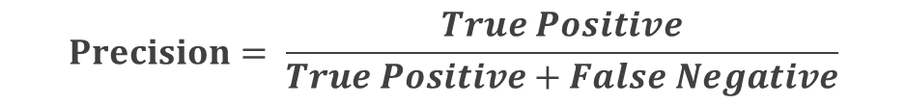

Supervised Learning (7)
Evaluation Metrics
3. Recall:
Recall calculates how many of the Actual Positives samples a model labels them also as Positive (True Positive). Applying the same understanding, we know that Recall shall be the model metric we use to select our best model when there is a high cost associated with False Negative.
4. F1-Score:
F1 Score might be a better measure to use if you need to seek a balance between Precision and Recall and there is an uneven class distribution. It’s just a simple fraction of precision and recall

Slide 16
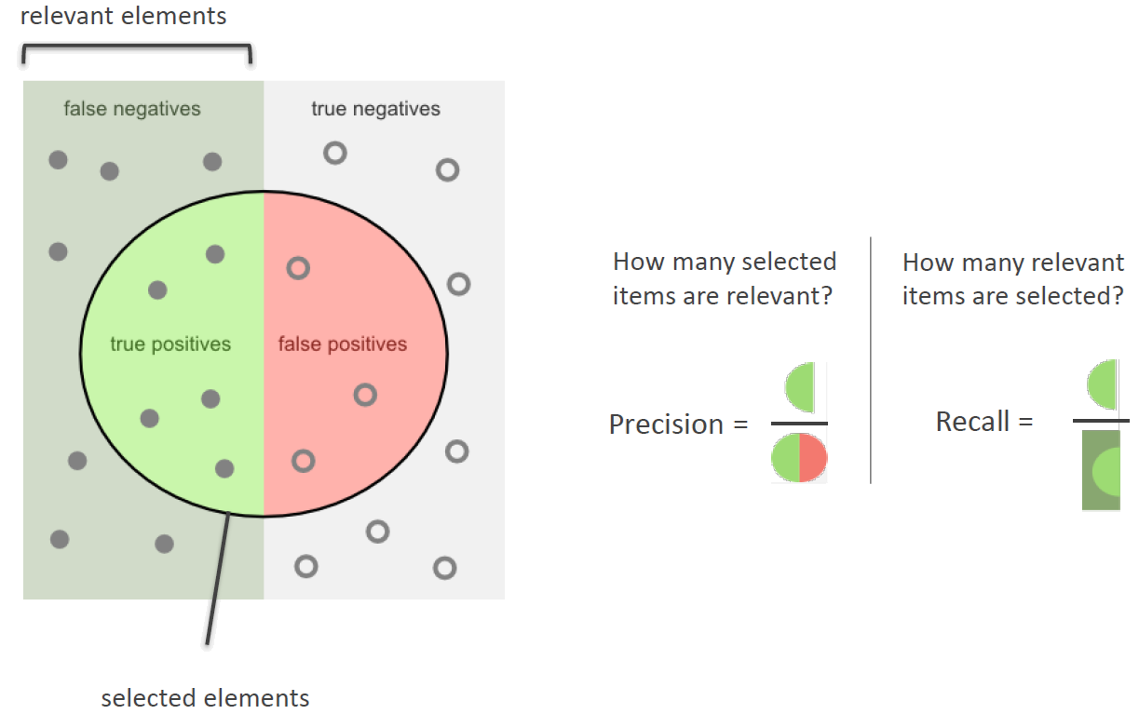
Supervised Learning (8)
Evaluation Metrics

Slide 17
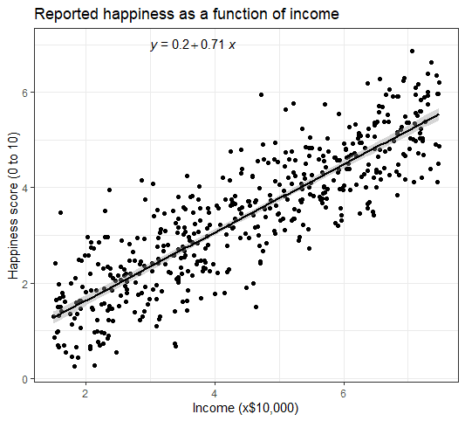
Supervised Learning (9)
Regression
Regression is a technique used to model the relationships between observed variables. The idea behind regression is to "fit" the observations of a number of variables into a relationship between them.
Graphically, for the simple case of two variables the task is to draw the line that is "best-fitting" or "closest" to the points (xi,yi) where xi and yi are observations of the two variable. So estimate a function f, whose graph fits the data.

Slide 18
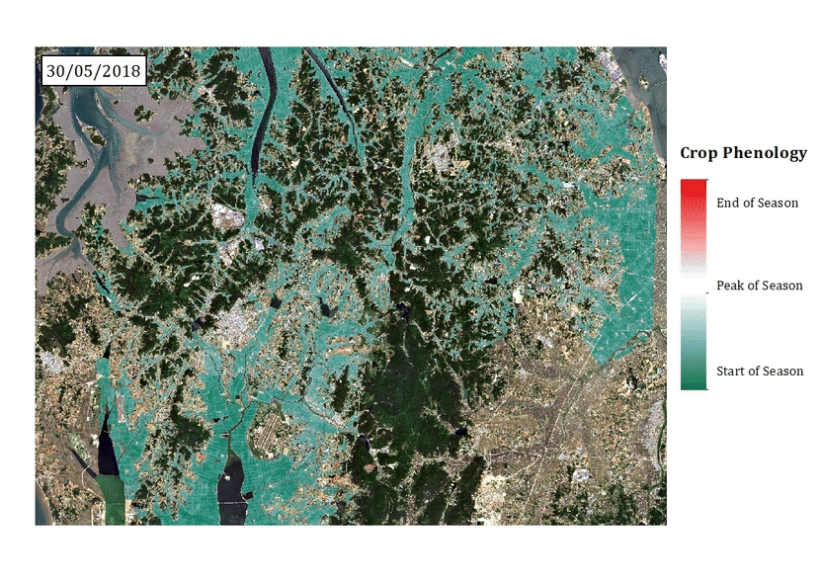
Supervised Learning (10)
Remote Sensing Regression example: Rice phenology estimation

Slide 19
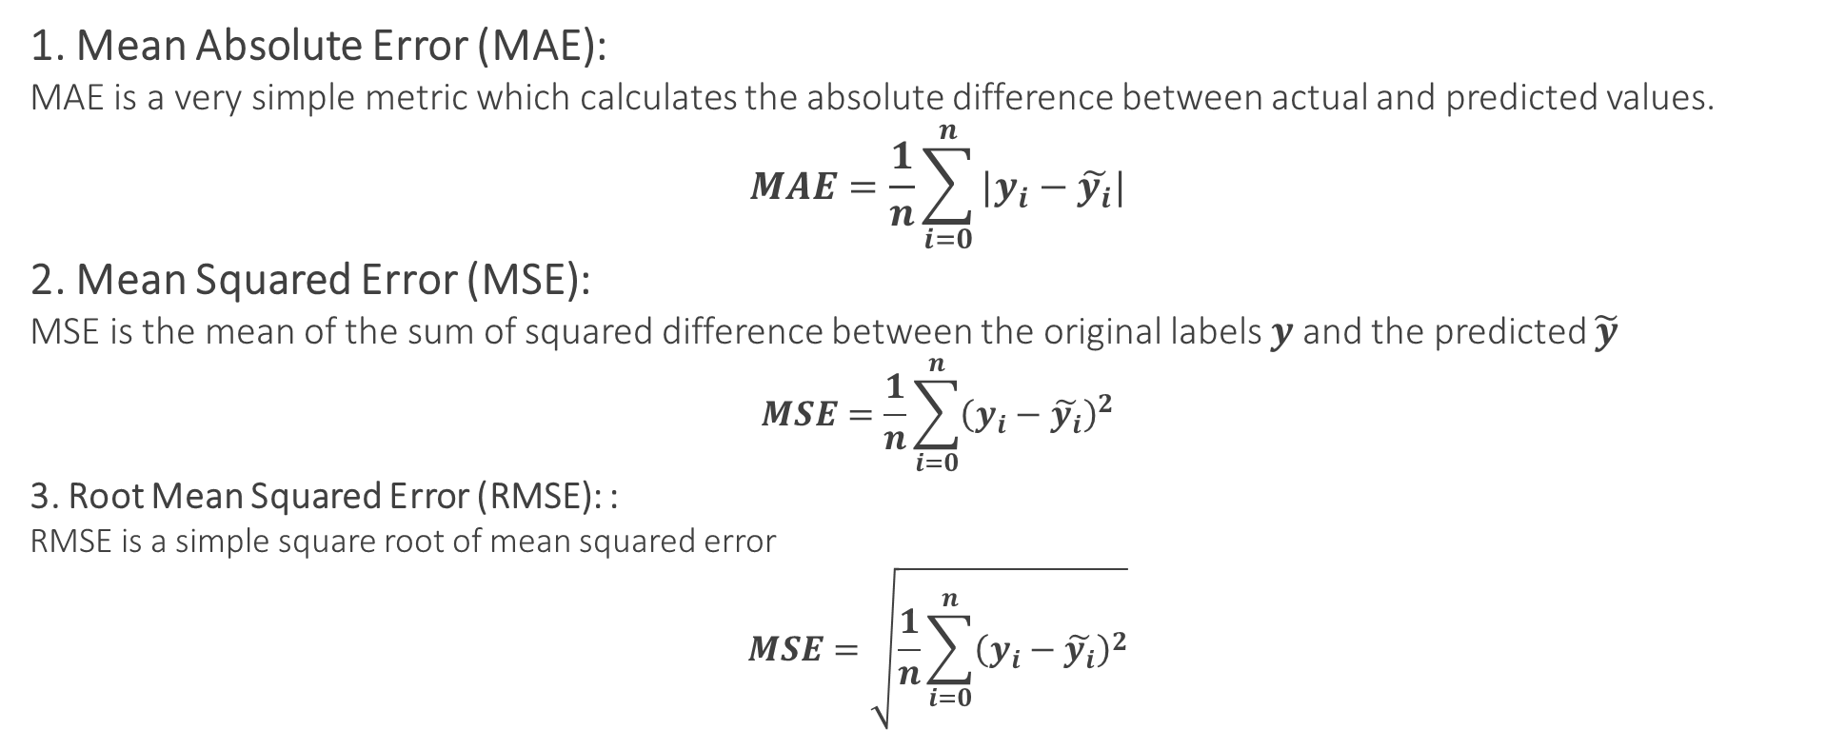
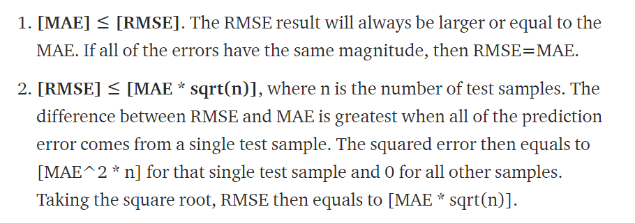
Supervised Learning (11)
Evaluation Metrics

Slide 20
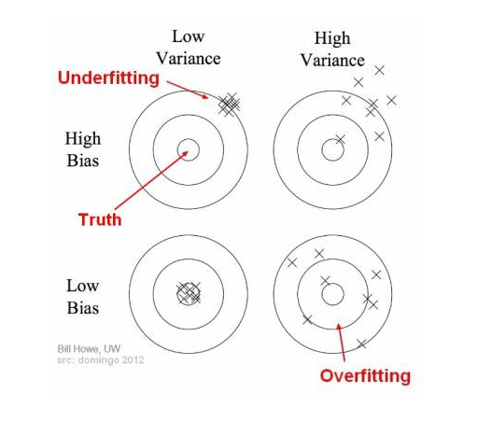
Supervised Learning (12)
Bias / Variance
Bias is the difference between the average prediction of our model and the correct value which we are trying to predict
high bias 🡪 high error
Variance is the variability of model prediction for a given data point or a value which tells us spread of our data
high variance 🡪 no generalization

Slide 21
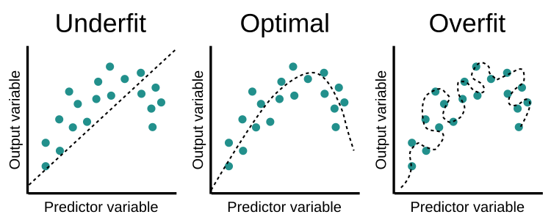
Supervised Learning (12)
Overfit / Underfit

Slide 22
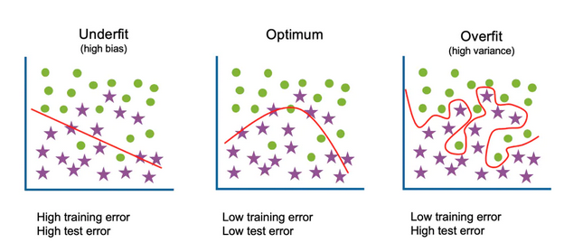
Supervised Learning (12)
Overfit / Underfit

Slide 23
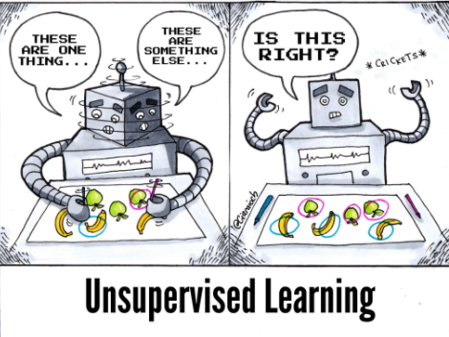
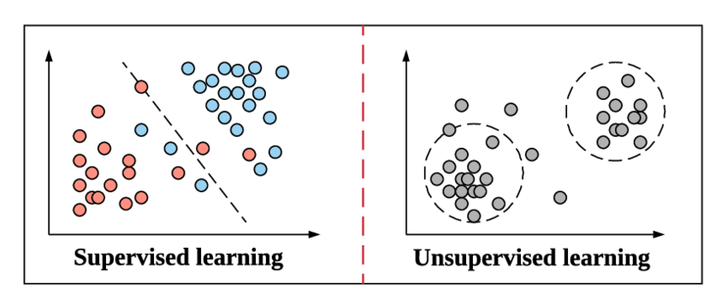
Unsupervised Learning (1)
Overview
So far we have focused on supervised learning where the examples in the training set are labelled training data: 𝑆 = { 𝑥𝑖, 𝑦𝑖 }
What if the labels are missing??
Unsupervised learning: No labelled examples at all
Semi-supervised learning: Few labelled examples, many unlabelled examples

Slide 24
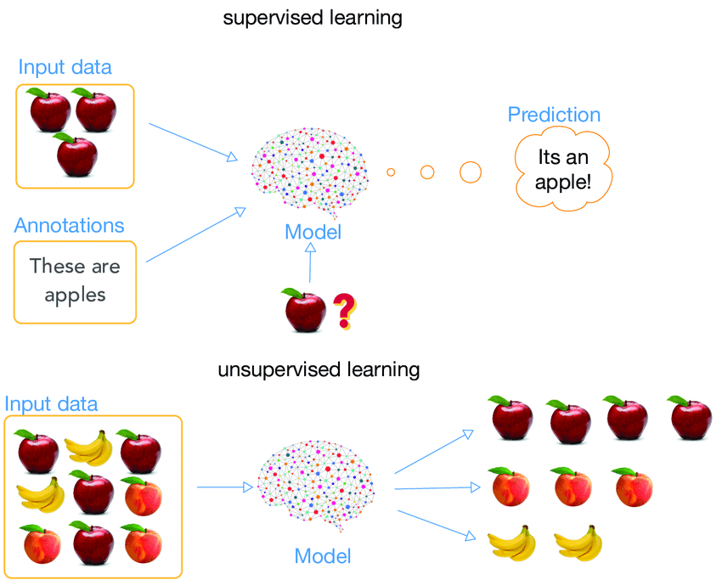
Unsupervised Learning (2)
Example

Slide 25
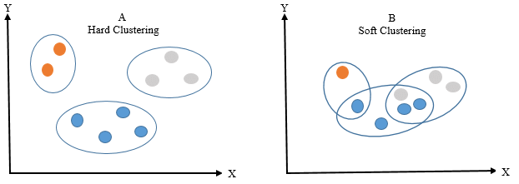
Unsupervised Learning (3)
Types of Unsupervised Clustering
Hard Clustering: each data point either belongs to a cluster completely or not.
For example: group people based on their age
Soft Clustering: a probability or likelihood of that data point to be in those clusters is assigned
For example: group into soft clusters based on brand choices

Slide 26
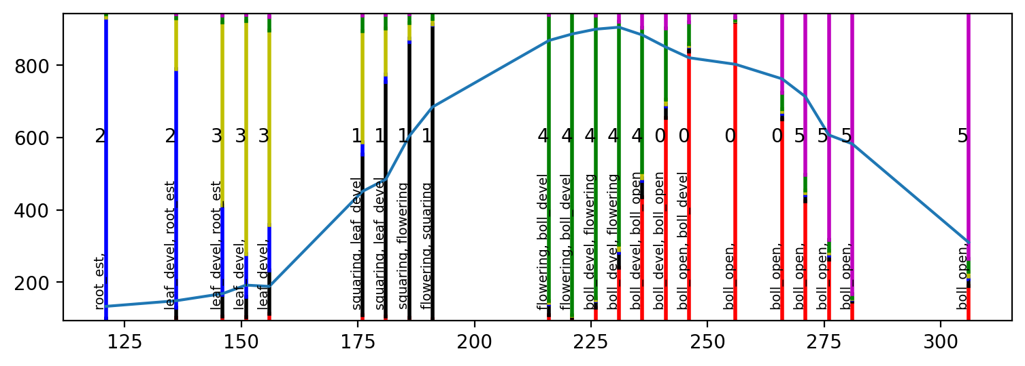
Unsupervised Learning (4)
Remote Sensing Soft Clustering Example: Cotton Phenology Estimation

Slide 27
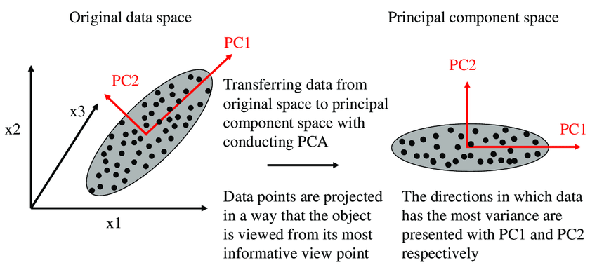
Dimensionality Reduction – PCA (Unsupervised)

Slide 28
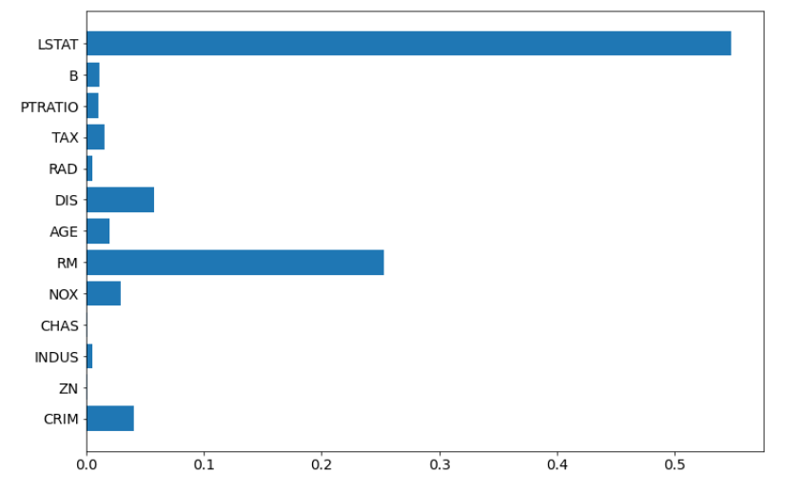
Dimensionality Reduction – RF Importances (Supervised)

Slide 29
Basic Machine Learning Algorithms
Classification
Naïve Bayes
Random Forest
Linear Support Vector Machines (SVM)
Clustering
K-means

Slide 30
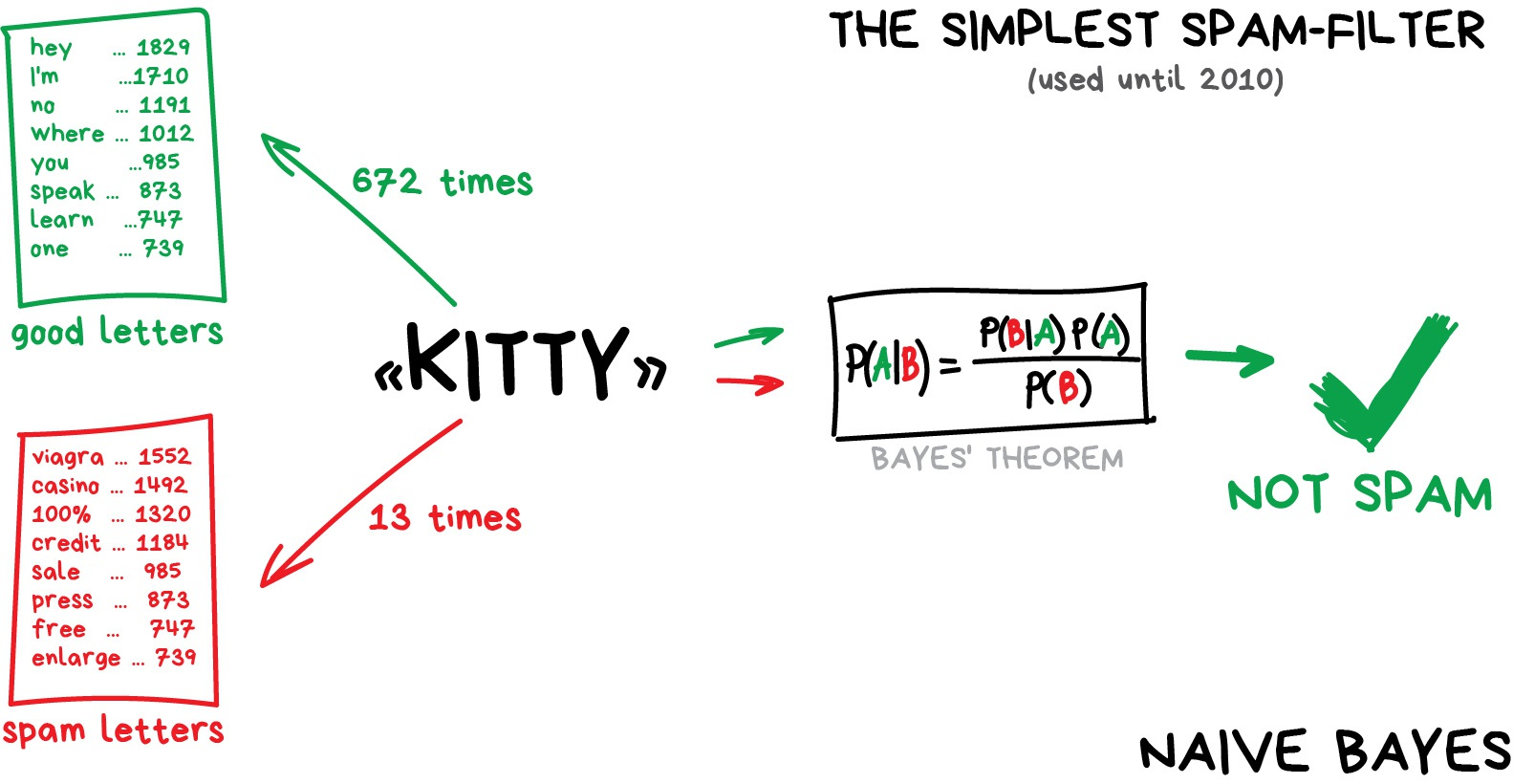
Basic Machine Learning Algorithms
Naïve Bayes

Slide 31
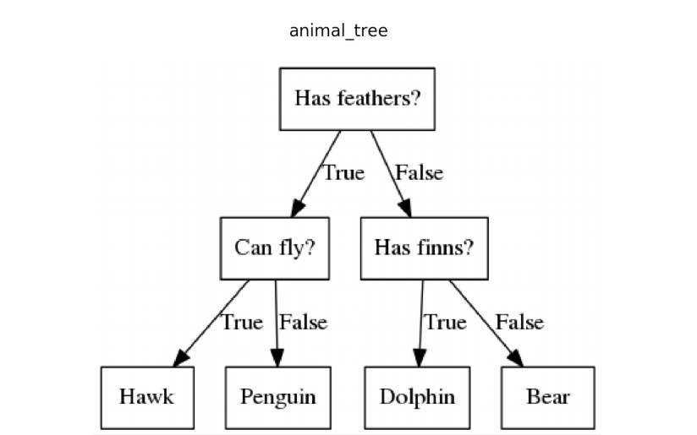
Basic Machine Learning Algorithms
Decision Trees
Decision Tree is one of the easiest and popular classification algorithms to understand and interpret. It can be utilized for both classification and regression kind of problem.
A decision tree is a flowchart-like tree structure where
an internal node represents a feature
the branch represents a decision rule
each leaf node represents the outcome
The topmost node in a decision tree is known as the root node. It learns to partition on the basis of the feature value. It partitions the tree recursively by recursive partitioning.
This flowchart-like structure helps you in decision making. It's visualization like a flowchart diagram which easily mimics the human level thinking. That is why decision trees are easy to understand and interpret.

Slide 32
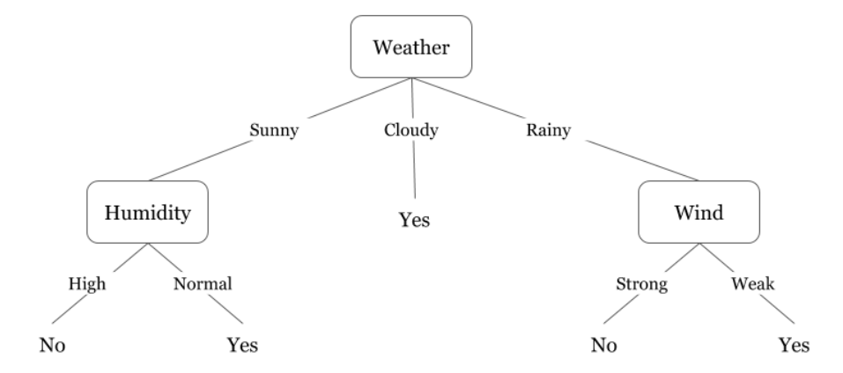
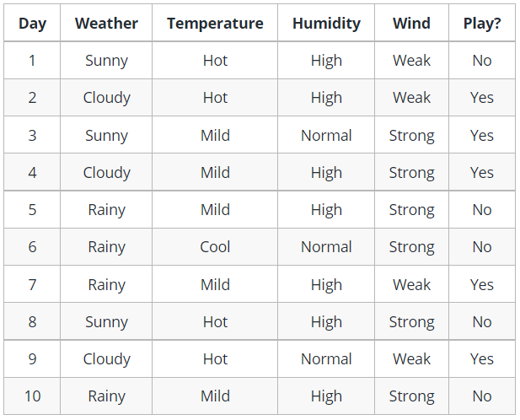
Basic Machine Learning Algorithms
Decision Trees - Example

Slide 33
Basic Machine Learning Algorithms
Decision Trees
How to do we decide which attribute to consider for the split?
We need a method that measures how well a decision for one attribute can split efficiently the data into more homogeneous subsets.
Some of the most known selection measurements are:
Entropy
Gini Index
Information Gain
Gain Ratio

Slide 34
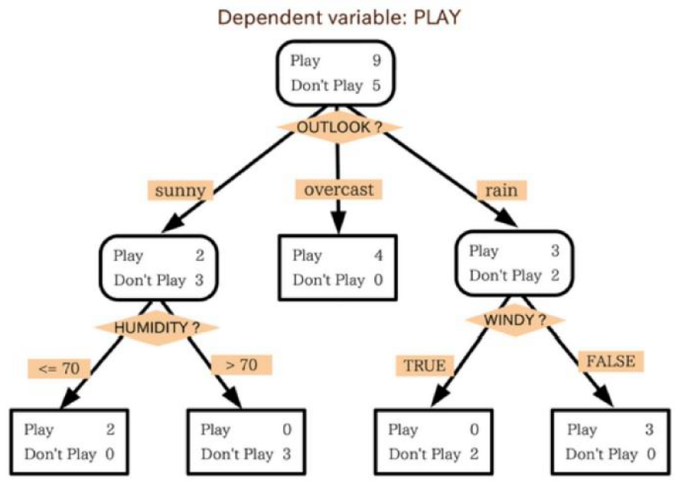
Basic Machine Learning Algorithms
Decision Trees - Example
Cloudy weather?
NO
YES
Sunny Weather?
PLAY
YES
NO

Slide 35
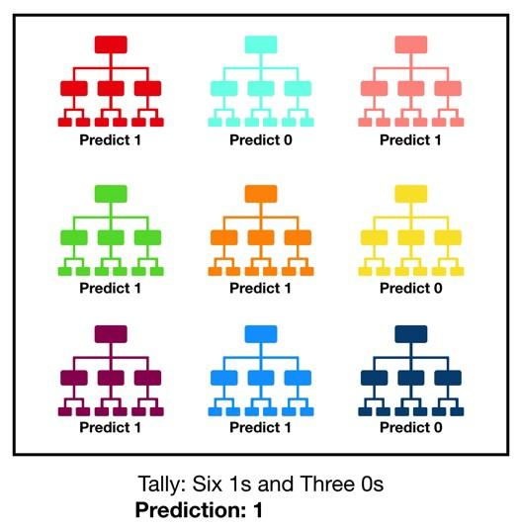
Basic Machine Learning Algorithms
Random Forest
Multiple individual trees
Voting mechanism
Bagging (Bootstrap Method)
Benefits??
“A large number of relatively uncorrelated models (trees) operating as a committee will outperform any of the individual constituent models.”
Unless there is a systematically occurred error, the errors of each individual tree are “corrected” by the other trees.

Slide 36
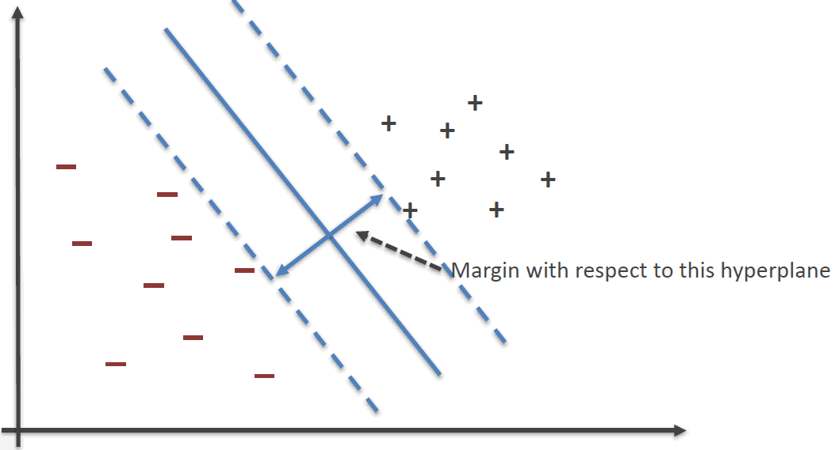
Basic Machine Learning Algorithms
Linear SVM
Supervised method for both classification and regression
Goal: Create the best line or decision boundary in order to easily put the new data point in the correct category in the future. This best decision boundary is called a hyperplane.
Extreme points/vectors (support vectors)
The objective of a SVM is to find the optimal separating hyperplane:
because it correctly classifies the training data
because it is the one which will generalize better with unseen data

Slide 37
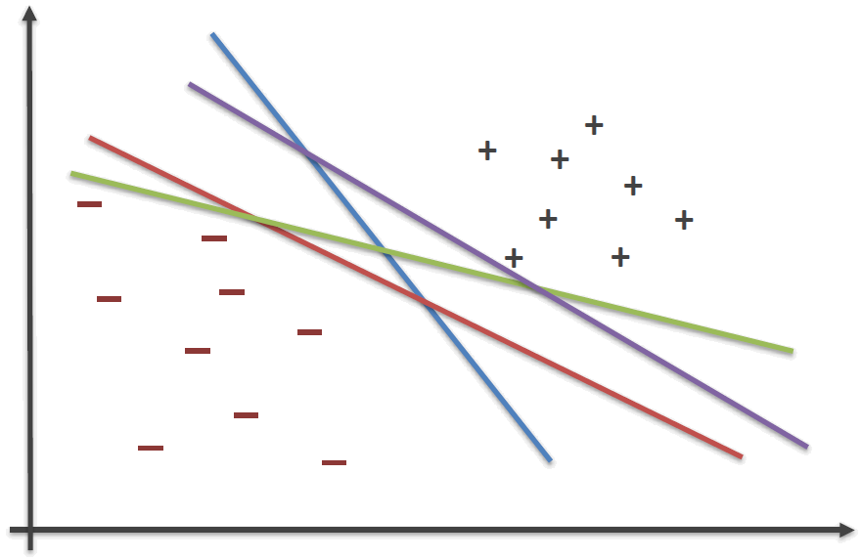
Basic Machine Learning Algorithms
Linear SVM
The fact that we can find a separating hyperplane, does not mean it is the best one !

Slide 38
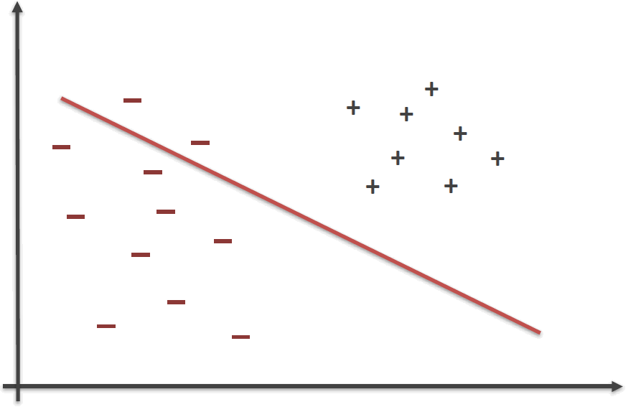
Basic Machine Learning Algorithms
Linear SVM
This hyperplane does not generalize well

Slide 39
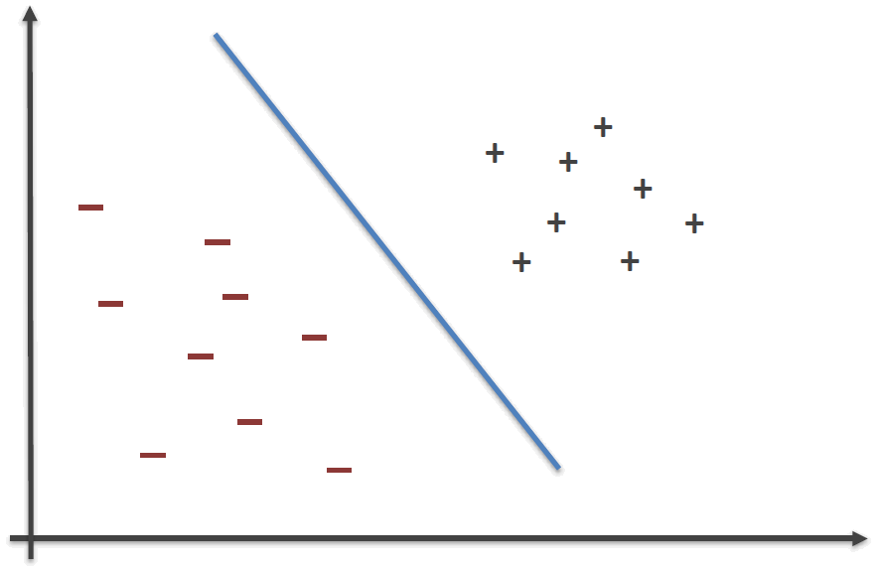
Basic Machine Learning Algorithms
Linear SVM
Try to select an hyperplane as far as possible from data points from each category

Slide 40
Basic Machine Learning Algorithms
Linear SVM
The margin of a hyperplane for a dataset is the distance between the hyperplane and the data point nearest to it

Slide 41

Basic Machine Learning Algorithms
Linear SVM
The margin of a hyperplane for a dataset is the distance between the hyperplane and the data point nearest to it

Slide 42

Basic Machine Learning Algorithms
Linear SVM
Importance of the margin!

Slide 43






Basic Machine Learning Algorithms
Non-Linear SVM

Slide 44

Basic Machine Learning Algorithms
K-means – Clustering (unsupervised learning)
Goal: Group data into a pre-defined number (K) of groups (clusters).
Iteratively each data point is assigned to one of K groups based on their features.
Data points are clustered based on feature similarity.
Results:
The centroids (means) of the K clusters, which can be used to label new data
Labels for the training data (each data point is assigned to a single cluster)

Slide 45

Basic Machine Learning Algorithms
K-means – Clustering (unsupervised learning)
The Κ-means clustering algorithm uses iterative refinement to produce a final result. The algorithm inputs are:
the number of clusters Κ
all features for each data point
Randomly select of generate Κ initial centroids. Then iterate:
The Data Assignment step
Each data point is assigned to its nearest centroid, based on the squared Euclidean distance
The Centroid update step
In this step, the centroids are recomputed. This is done by taking the mean of all data points assigned to that centroid's cluster.
The algorithm iterates between steps one and two until a stopping criteria is met i.e.
no data points change clusters,
the sum of the distances is minimized,
some maximum number of iterations is reached.

Slide 46

Basic Machine Learning Algorithms
K-means – Clustering (unsupervised learning)
Example

Slide 47

Basic Machine Learning Algorithms
K-means – Clustering (unsupervised learning)
Example

Slide 48

Basic Machine Learning Algorithms
K-means – Clustering (unsupervised learning)
Example

Slide 49

Basic Machine Learning Algorithms
K-means – Clustering (unsupervised learning)
Example

Slide 50

Basic Machine Learning Algorithms
K-means – Clustering (unsupervised learning)
Example

Slide 51

Basic Machine Learning Algorithms
K-means – Clustering (unsupervised learning)
Example

Slide 52

Basic Machine Learning Algorithms
K-means – Clustering (unsupervised learning)
Example

Slide 53

Basic Machine Learning Algorithms
K-means – Clustering (unsupervised learning)
Example

Slide 54

Basic Machine Learning Algorithms
K-means – Clustering (unsupervised learning)
Example

Slide 55

Basic Machine Learning Algorithms
K-means – Clustering (unsupervised learning)
Example

Slide 56

Basic Machine Learning Algorithms
K-means – Clustering (unsupervised learning)
Example

Slide 57

Basic Machine Learning Algorithms
K-means – Clustering (unsupervised learning)
Example

Slide 58

Basic Machine Learning Algorithms
K-means – Clustering (unsupervised learning)
Example

Slide 59

Basic Machine Learning Algorithms
K-means – Clustering (unsupervised learning)
Example

